Slide 1
Subcommittee:
Social Determinants of Education

Slide 2
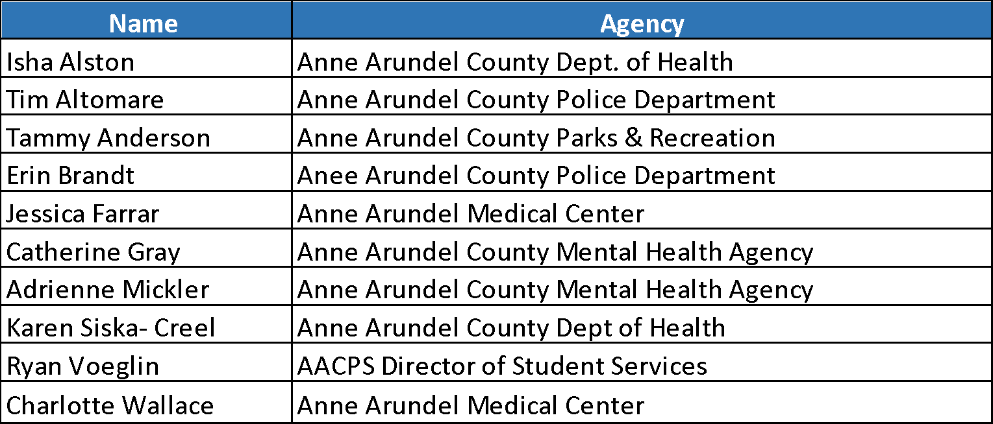
Social Determinants of Education Collaborative Team:

Slide 3
Community Response: Roots
Systemic Poverty
Poor Academic Achievements
Lack of Resources
Trauma
Notes:
We heard you! Thank you for your comments. Many of our children are in crisis. Hard to learn when in crisis. When grades start slipping easier to be disruptive or absent than make up the work.
Poverty
Trauma
o Victimization gangs – threats of ICE
o Bullying/ cyberbully
o Parents/family in crisis
Lack of resources
o Lacking culturally sensitive resources in general
o When resources are there, some of our most vulnerable families are unable to access them.

Slide 4
Community Response: Systemic Poverty
Income:
Poverty
Income inequity

Slide 5
Community Response: TRAUMA
Adverse Childhood Experiences (ACEs)
Witnessing mother abused or mistreated
Emotional and physical abuse and neglect
Sexual assault
Living with parent who is depressed or untreated mental illness
Live with a parent who is an addict
Close family member going to jail
Neighborhood violence
Exposure to gangs
Single parent family home
Racism

Slide 6
Community Response: Lack of Resources
Access to Care
Health
Dental
Mental/ behavioral services
Wrap around services
Early Childhood
Prenatal care
Teenage pregnancies
Social support
Single parent support
Affordable childcare

Slide 7
Food
Free & reduced meal programs (AACPS)
Summer Food Program
Food deserts
Supplemental nutrition
Food pantries
Employment
Training
Opportunities
Incarceration

Slide 8
Education
Supplemental programing (STAIR)
Tutoring
Drop outs
Student teacher ratio
Teacher training on
mental health
Universal Pre-K
Library
Technology
Access to computers
Housing
Homeless children
Affordable housing
Utilities
Environmental exposures

Slide 9
Transportation
Public transportation
Academia
Safe self transportation (bike)
Medical transportation
Systemic Racism
Mass incarceration
Harmful public policies
Lack of diverse teaching staff
School label
Student label
Male Role Models
Absent fathers

Slide 10
Community Response: Proposed Solutions
Improved
Collaboration
Improved
Communication

Slide 11
What: Wrap Around/ Therapeutic Nursery for high risk newborns- preschoolers
Why: Provide early interventions, build trust among families and family support services, while improving health and educational outcomes in the long term.
• Who:
newborns (0-4 mo.)
infants (4-12 mo.)
toddlers (1-2yrs)
preschoolers (3-5 years)
• Where: in child’s home
• When: summer 2020
• Which: A designated number of flags would prompt a referral including: teenage mother, single parent, on Medicaid, screened toxic positive, poor attachment, adoption, learning disabilities (for example: Down Syndrome), etc.

Slide 12
Why:
Many of our support services are reactive.
We need our support services to be more proactive.
Notes:
“A hand up, not just a hand out”

Slide 13
Why:
Currently newborns with a potential high risk for Adverse Childhood Experiences (ACEs) are not connected to services unless the family is already in crisis.
What the research shows us:
0-6 years old is the most critical time for brain development.
Direct correlation with the number of Adverse Childhood Experiences (ACEs) and...
Education (poor academic achievement, learning disabilities, drop out rates, etc.)
Behavioral (substance misuse/abuse, smoking, etc.)
Cognitive (lower IQ scores, learning disabilities, trouble focusing, etc.)
Physiological (cardiovascular disease, diabetes, life expectancy, etc.)
Social (difficulty trusting, risk taking, etc.)
Emotional (irritable, depression, etc.)
Adapted from Felitti, Anda, Nordenberg, Edwards, Koss, Marks, et al. (May, 1998) Relationship of childhood abuse and household dysfunction to many of the leading causes of death in adults. American Journal of Preventive Medicine 14(4), 245-258.
Notes:
No quick fix – need long term supportive services for individual and family
Those with 6 or more Adverse Childhood Experiences died nearly 20 years earlier on average (60.6 years vs. 79.1 years).

Slide 14
Why:
Primary Prevention - Eliminate young children’s exposure to adverse conditions, such as abuse, neglect, violence or substance disorder.
Stable, nurturing relationships with caring adults can prevent or reverse the damaging effects of toxic stress.
Secondary Prevention - Early identification of high risk for ACEs and support to reduce exposure.
Tertiary Prevention - Mitigation of the negative consequences of toxic stress.
Adapted from: Overcoming childhood Adverse experiences; creating hope for a healthier Arizona. Found at https://www.childhealthdata.org/docs/drc/arizona-aces-efinal.pdf
Notes:
Call to action to create a safe spaces and strong healthy communities for children.

Slide 15
When & How
GOAL: Promote early identification and expansion of family support system interventions for 0-6 y/o identified as high risk for ACEs.
February - March 2020
Collaborate with Anne Arundel County’s Local Interagency Coordinating Council (LICC).
Gather data on current 0-5 y/o programing in Anne Arundel County:
capacity, clientele, area of focus, geographical range, measure of success, etc.
Perceived barriers, gaps, ability to expand services, etc.
Determine top 3 geographical priority areas of highest need
April - May 2020
Determine phases of implementation and community partnerships
Determine budget for implementation
Determine how to measure success for evaluation of impact
Finalize proposal
Notes:
When & How:
(Please recap your goal and action steps and pay special attention to the timeline. Make clear the alignment of your goal as you reference benchmarks and milestones.)

